Slide 1

FAKE NEWS DETECTION AND VERIFICATION TOOL
Presented By:
👉 Name : JANANI A
👉Mentor : V. Manjuladevi
👉Dept/College :CSE/Kingston Engineering College

Slide 2
INTRODUCTION:
AI-Powered Fake News Detection using LLMs.
Truthguard is designed as a smart verification tool that uses Natural Language Processing (NLP) and LLM-based semantic understanding to evaluate news content deeply rather than relying only on keywords.
The system understands the context, intent, and factual consistency of the news and compares it with trusted sources to determine its credibility.

Slide 3

Project Statement & TruthGuard Introduction
In today’s digital world, fake news spreads rapidly through social media and online platforms, misleading users and causing misinformation.
Manual verification is time-consuming and unreliable.
Hence, there is a need for an automated, intelligent system to detect and verify fake news accurately.
Truthguard is an AI-based fake news detection and verification tool that analyzes news content or URLs and determines whether the information is Real, Suspicious, or Fake using Large Language Models and fact-checking techniques.

Slide 4
How It Works
1. Paste Content
2. AI Analysis
3. Get Results
5. Make an Informed Choice
4. Ask TruthBot
Paste the content → AI checks it → Get result → Ask questions → Decide wisely.

Slide 5
Outcomes of the project
Automatically detects fake and misleading news content
Classifies news as Real, Suspicious, or Fake
Generates a credibility score for better
understandingVerifies claims using trusted sources and AI analysis
Reduces the spread of misinformation on digital platforms
Provides explainable AI results for transparency
Saves time compared to manual fact-checking

Slide 6
Modules to be Implemented
1.User Authentication Module
secure login and registration.
2.Input Processing Module
Accepts text or news article URLs.
5.Claim Verification Module
Verifies claims using Fact-checking APIs
Generates Credibility score
6.Explainability & Visualization Module
Highlights suspicious content
Shows reasoning behind predictions
7.Admin Dashboard Module
Monitors usage , analytics, and system performance
3.LLM Analysis Engine
Uses Google Gemini LLM
4.Classification Module
Classifies news as real,Suspicious, or Fake

Slide 7
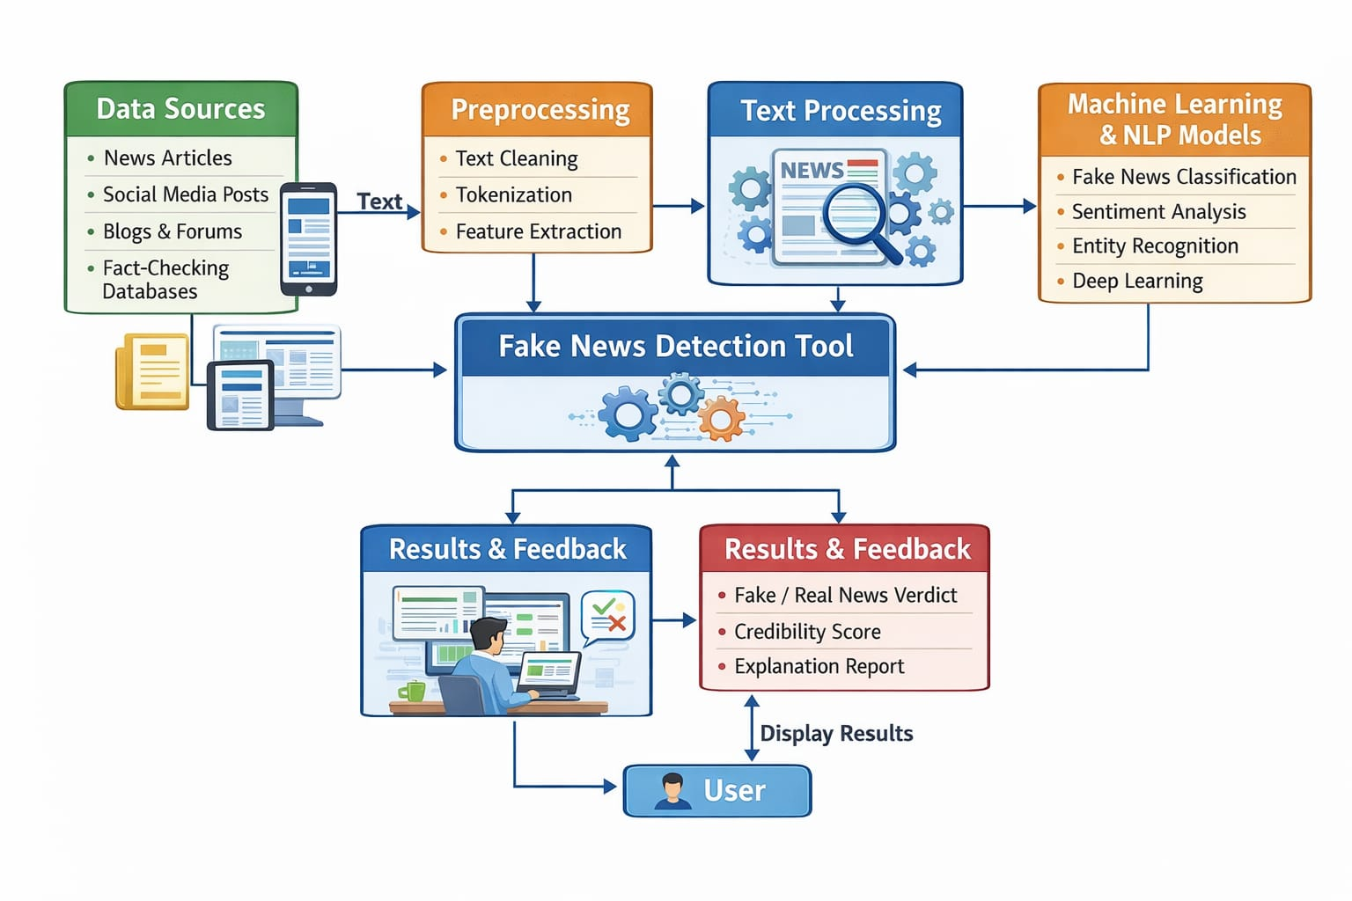
System Architecture
Flow:
User → Frontend → Backend API → Gemini LLM → Database→Result to User
Presentation Layer:
Built using HTML , CSS, Javascript.
Application Layer:
Flask REST API handles requests , Controls verification workflow.
Data Layer:
Stores users, news data, and results , Uses relational database

Slide 8
Database Schema & Technology Stack
Database Schema
Technology Stack
Users Table: User ID, Name, Email, Password
News Table: News ID, Content / URL, Date
Results Table: Credibility Score, Classification, Explanation
Logs Table: User activity and verification history
Frontend: HTML, CSS, JavaScript
Backend: Python, Flask
AI Model: Google Gemini LLM( BERT, RoBERTa )
Database: PostgreSQL / SQLite
APIs: Fact-Checking APIs
Authentication: JWT

Slide 9
Conclusion
TruthGuard provides a reliable and intelligent solution for detecting fake news using AI and LLM technologies.
The system improves information credibility, promotes digital responsibility, and helps users make informed decisions in the digital era.

Slide 10
Sample Output
Output:
Classification: ❌ Fake
Confidence Score: 89.6%
Credibility Score: 2.1 / 10
Sentiment Score: 0.00
Verification Status: Mismatch with verified government sources
Correct Information:
  The capital of India is New Delhi
User enters news text or URL
System analyzes content
Displays:
  Credibility Score
  Classification (Real / Suspicious / Fake)
  Explanation and highlights
Input Text:
“Mumbai is the capital of India.”
Explanation:
This statement contradicts officially verified geographical facts.

Slide 11
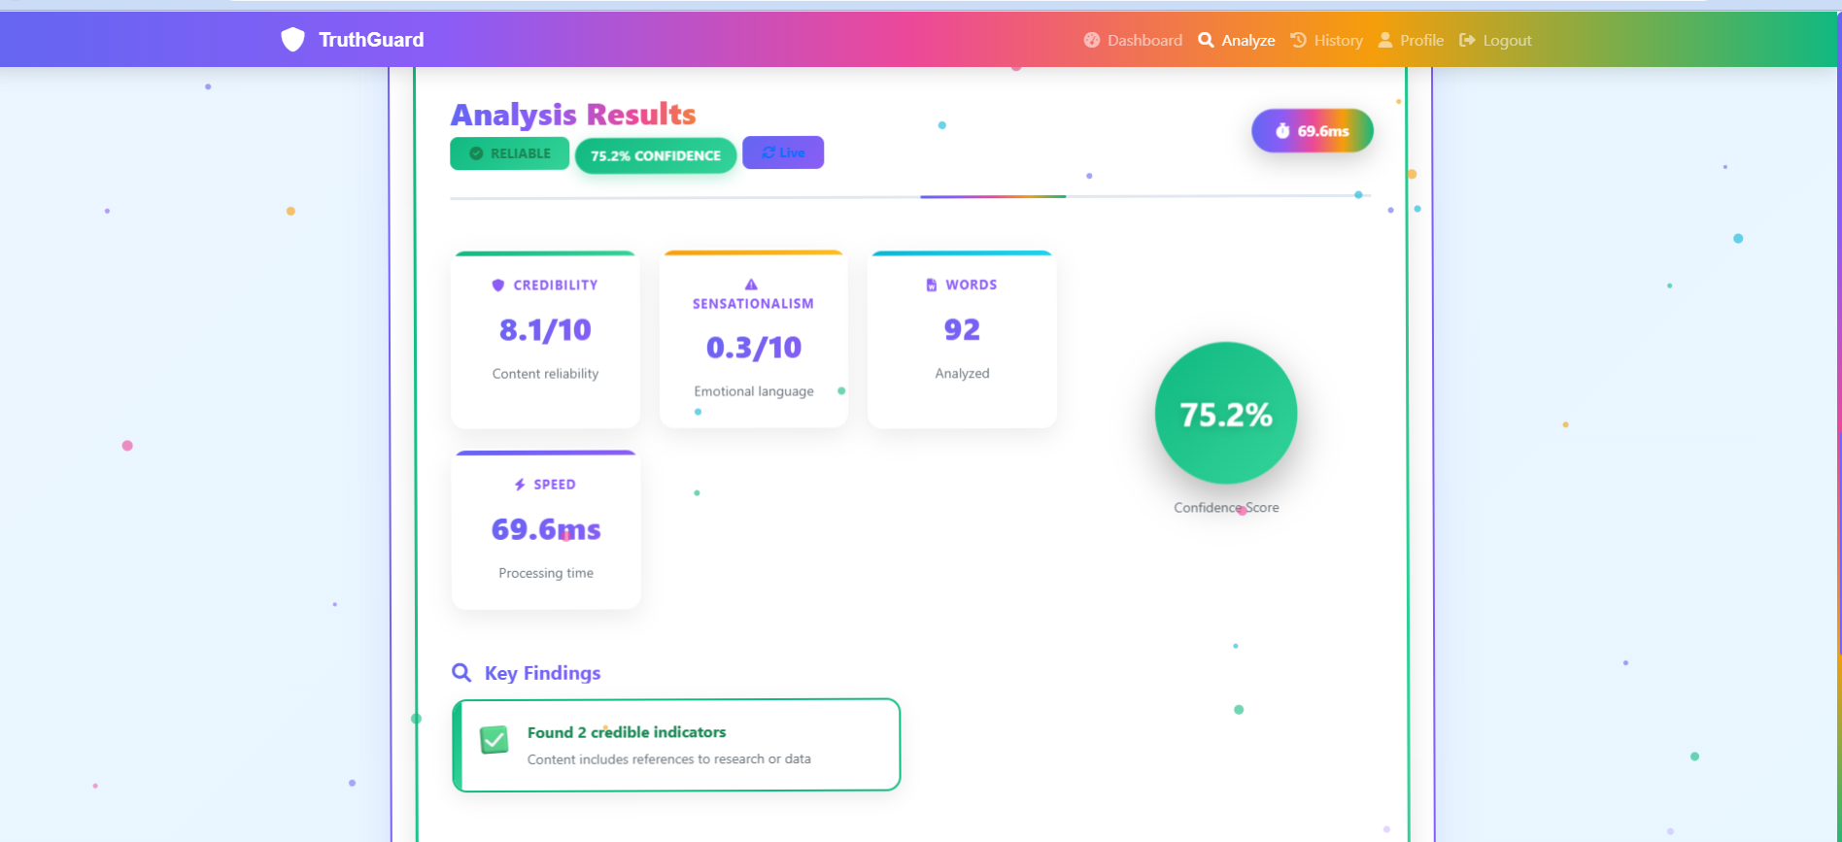
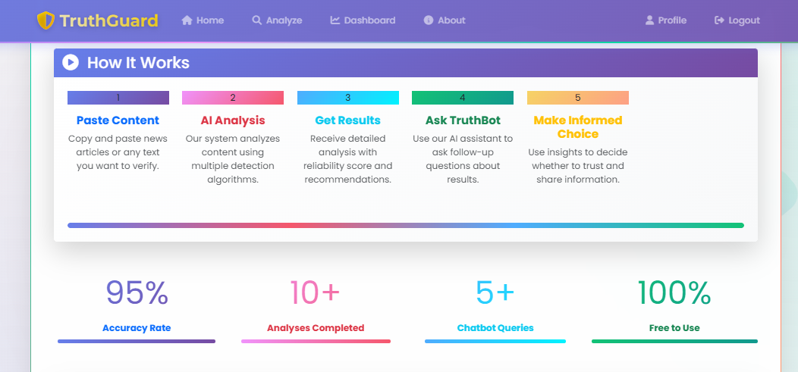
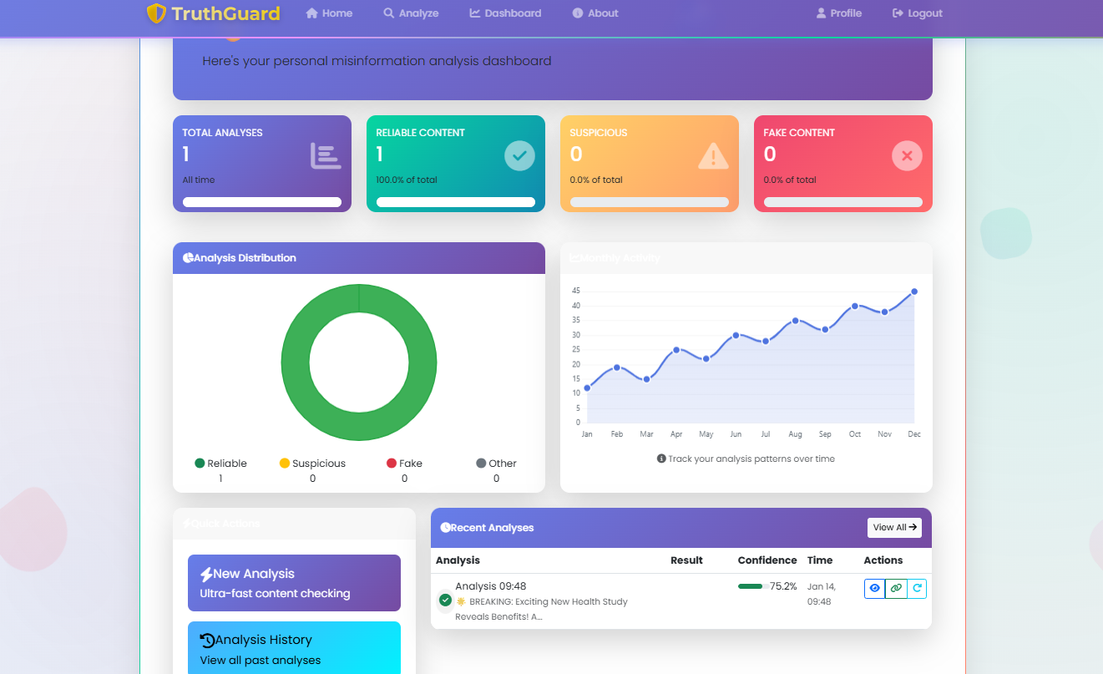

Slide 12
THANK YOU!!

